Slide 1
Good <Morning/Evening/Afternoon>!!!
We’ll start in the next few minutes. Until then, make yourself comfortable!
How are you feeling today? Drop an emoji in the chat!
All the exercises will be performed on your own device in a web browser. Start by cloning two Azure Notebooks:
https://notebooks.azure.com/sguthals/projects/data-science-2

Slide 2
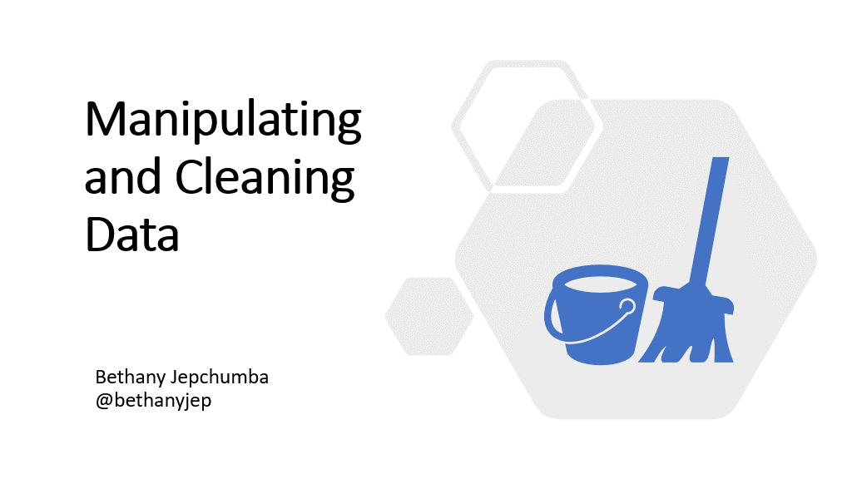

Slide 3
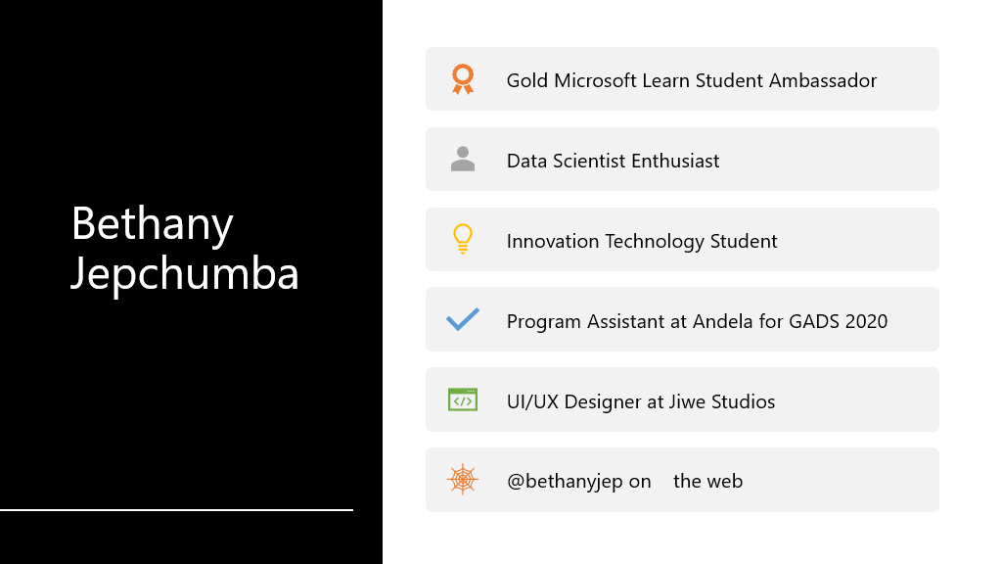

Slide 4
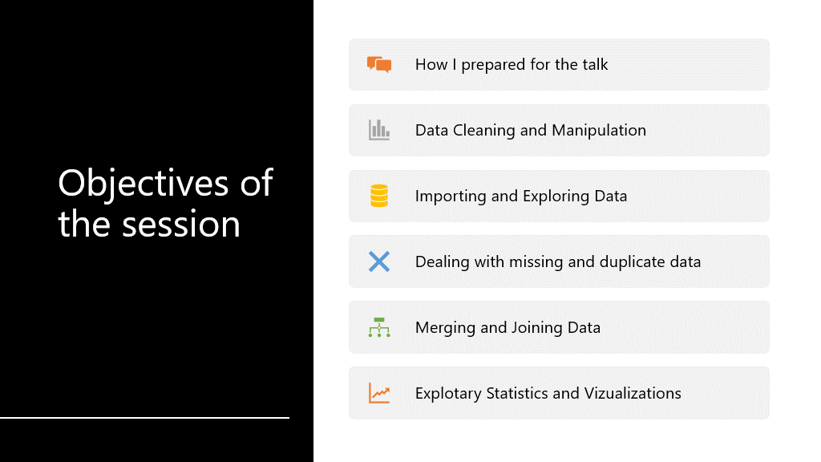

Slide 5
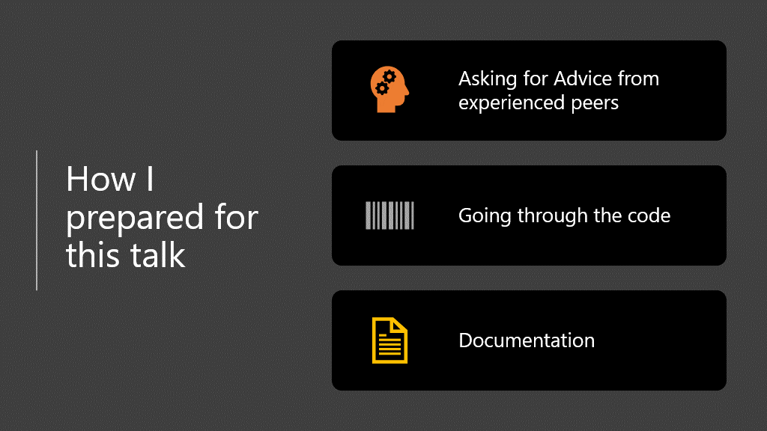

Slide 6
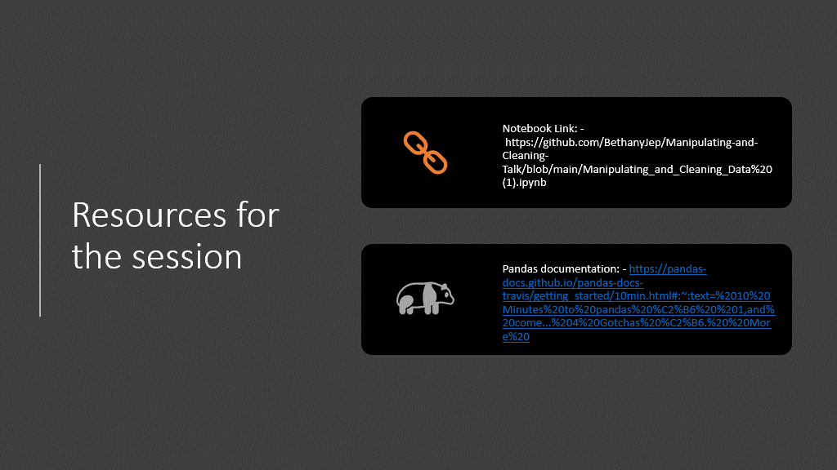

Slide 7


Slide 8
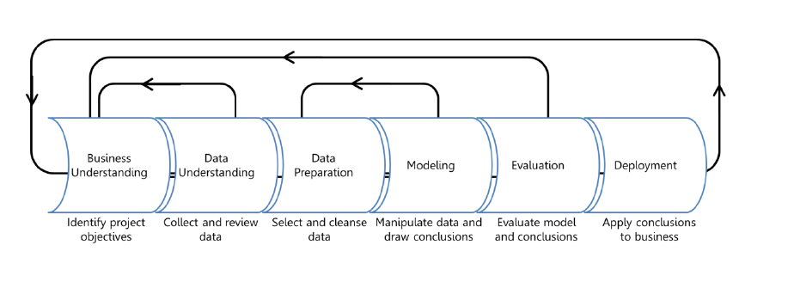
Data Science Process
Extracting value from large amounts of data and making human sense of it is the primary challenge of data science.

Slide 9
How to Navigate VSCode Notebooks

Slide 10


Slide 11
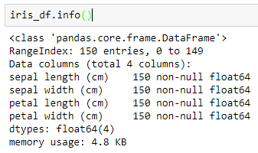
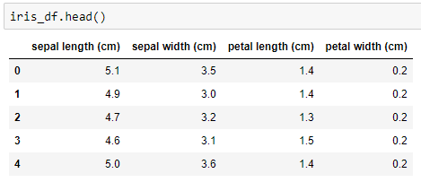
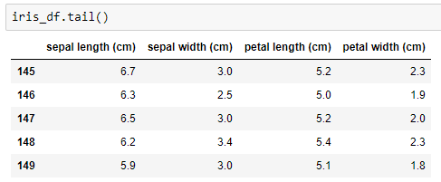
Exploring DataFrame information
DataFrame.info
DataFrame.head
DataFrame.tail

Slide 12
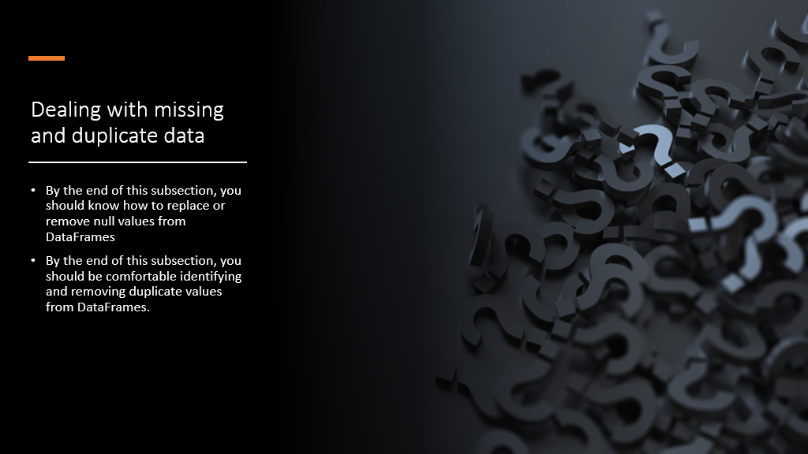

Slide 13

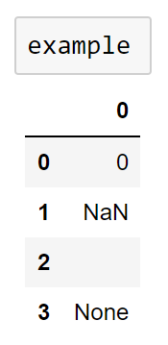
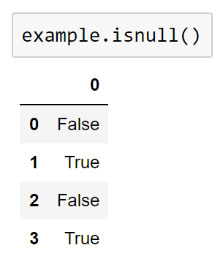
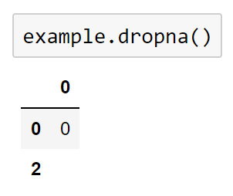
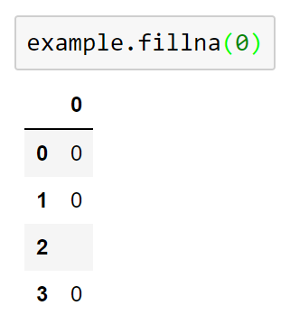
Dealing with Missing Data
Python null value: None
NumPy/pandas null value: NaN

Slide 14
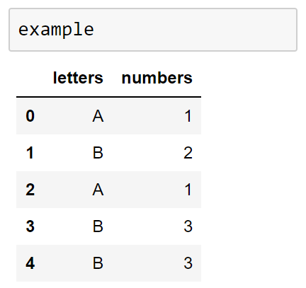
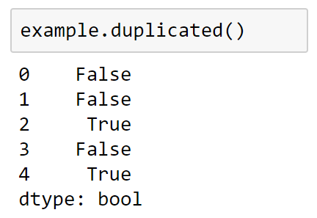
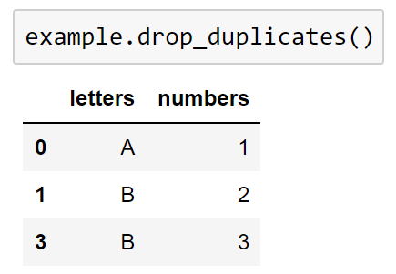
Removing Duplicate Data
Identifying duplicates
Dropping duplicates

Slide 15
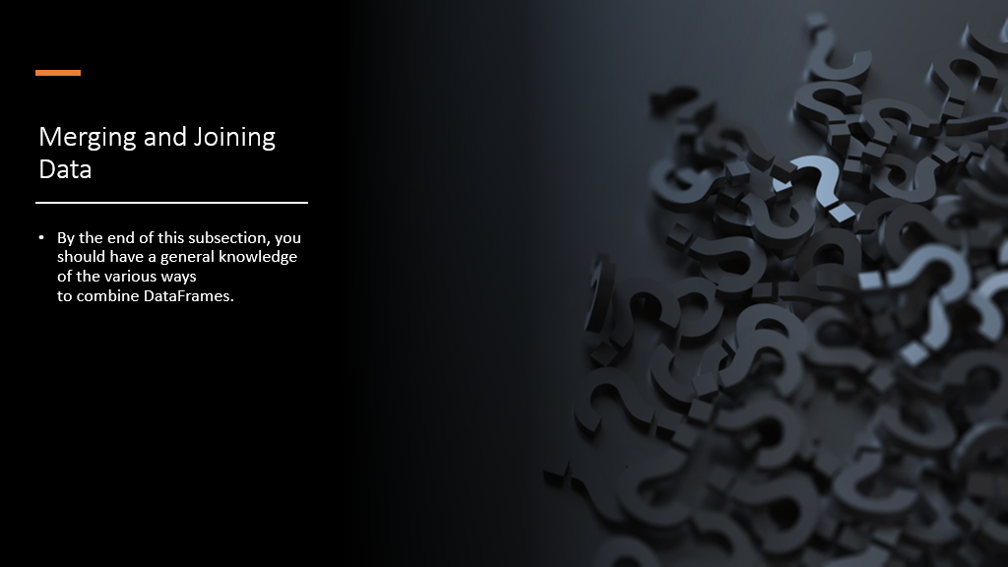

Slide 16



Combining Datasets
Categories of joins:
one-to-one, many-to-one, and many-to-many
Concatenation in NumPy:
Concatenation in pandas:
Concatenation with joins:

Slide 17


Slide 18
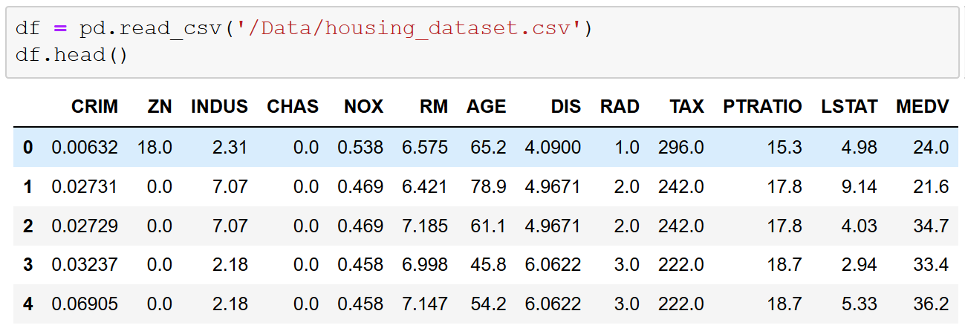
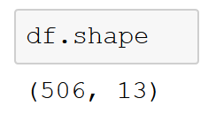
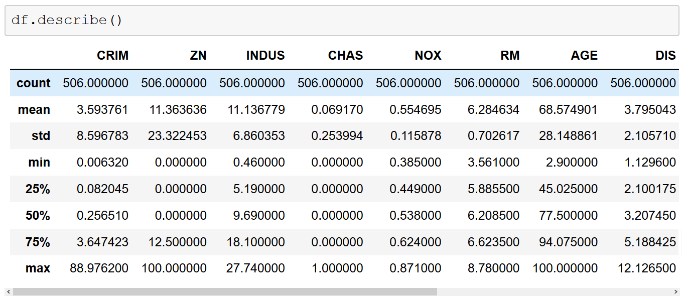
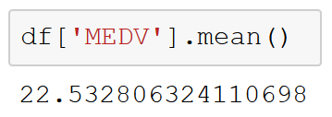
Exploratory Statistics and Visualization

Slide 19

Any Questions

Slide 20
Additional Resources
Beginners Data Science for Python developers: https://github.com/microsoft/Reactors/tree/main/workshop-resources/data-science-and-machine-learning/Data_Science_2
Manipulating and Cleaning Data Notebook: https://github.com/microsoft/Reactors/blob/main/workshop-resources/data-science-and-machine-learning/Data_Science_1/workshop-materials/4-Cleaning_and_Manipulating.ipynb

Slide 21
Thank you!

